Slide 1
Attack on Practical Speaker Verification System
Anirudha Kulkarni - 2019CS50421
Prakhar Aggarwal - 2019CS50441
Pratyush Saini - 2019CS10444

Slide 2
Introduction
Practical speaker verification:
Identify individuals based on their unique voice biometrics without requiring users to be present physically at the verification location.
Parts:
Audio replay check
Speaker identity check
Speech content check.
DNN based Speaker Recognition

Slide 3
Problem
Analyzing the vulnerability of the Speaker Recognition Systems by adding a well-crafted inconspicuous noise to the audio and forcing the model to recognize it as any adversary desired speaker.
Importance?
Speaker Recognition models can be used to facilitate a series of security-enhanced voice-based applications
Using speaker recognition technologies to let people gain access to information or give authorization without being physically present

Slide 4
Related Work
Replay attack:
uses pre-recorded voice samples of the user
less effective as the inconsistency in the voice could alert the staff and the attack
Speech synthesis attack:
generate a victim’s voice by learning an acoustic model from a limited set of voice samples
human and synthetic speeches could be differentiated with higher order Mel-cepstral coefficient
Impersonation/voice conversion attack;
defended by PLDA and Factor Analysis (FA)

Slide 5
Related Work
Attacks targeting Speaker Recognition Model only:
“Adversarial attacks on gmm ivector based speaker verification systems”
“Adversarial attacks on spoofing countermeasures of automatic speaker verification”
“Who is real bob? adversarial attacks on speaker recognition systems”
“Learning to fool the speaker recognition”
“Practical adversarial attacks against speaker recognition systems”
Failed on Speech content check and audio replay check
Asynchronous attacks:
Adversarial perturbation without perturbation
Universal Attacks:
Text independent perturbation

Slide 6
Objectives
Given a speaker and target speaker,
Generate adversarial noise,
Text independent
Asynchronous
Analysis of Training:
Evolution of noise with training
Behavior of the features with training
Visualize the results

Slide 7
Components
Pretrained Speaker Recognition model
ResNetSE34V2
8M parameters
Trained based on 'In defence of metric learning for speaker recognition'
Dataset:
LibreSpeech link
40 speakers: 20 Male, 20 Female
10-20 Seconds
Attack Model:

Slide 8
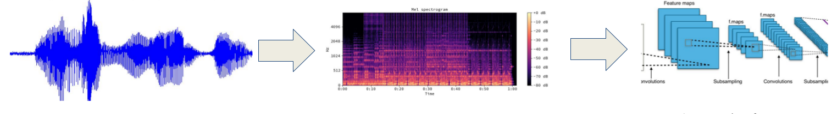
Audio Input Pre-processing
A DNN-based pre-trained speaker verification model is used to encode the speaker feature representation from audio
Input Audio Files
Mel Spectrogram
(logarithmic transformation of signal frequency)
ResNet-34 convolutional layers. Extract frame level features
Notes:
MEL Scale is logarithmic transformation of signal frequency.

Slide 9
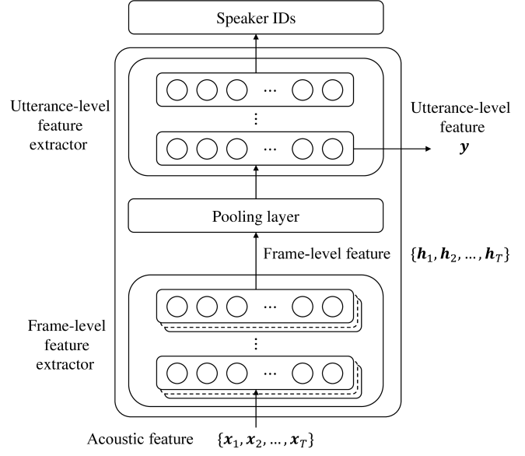
Speaker Feature Recognition from Audio
Speaker Representation features
Features with max weighting utilizing attention ?
Statistic pooling is used to extract utterance level representation vector
Notes:
under noisy and unconstrained conditions, where irrelevant parts of the signal must be filtered out. [Statistic pooling]. Attraction score. n. Finally, a fully connected layer is used to map the statistics into a fixed dimension vector witch is the speaker feature representation.

Slide 10
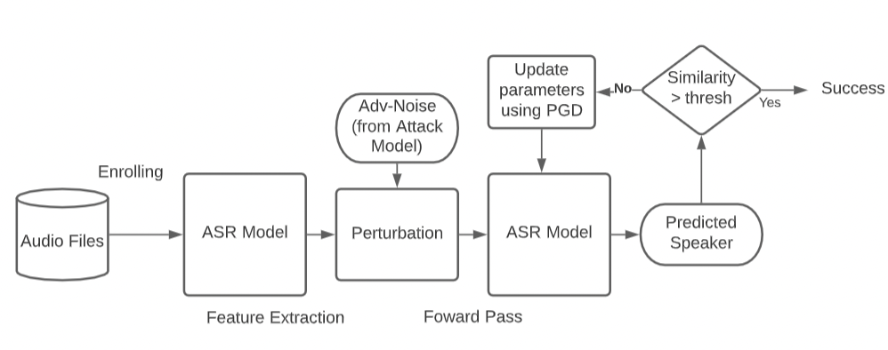
Flow Chart of Threat Model
Optimizing Adversarial Perturbation : 2 step process (Next Slides)

Slide 11
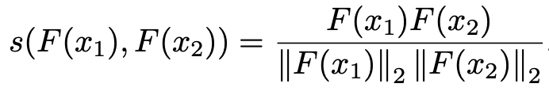
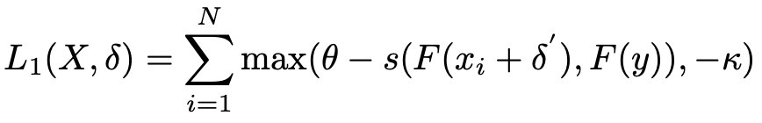
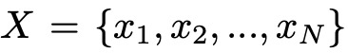
Step1: Maximizing Attack on ASV Model
Goal: Make δ effective to fool the Speaker Recognition Model
Need to find an adversarial noise δ such that s(F(x+δ), F(y)) ≥ θ
Minimization Objective: Carlini-Wagner (CW) Like Loss function
Notes:
N audios of the adversary are collected to form a training set X. s(F(x+del, F(y))is the score between the feature representation of the adversary and targeted speaker. a large κ can get high attack success rate on other test audios of the adversary.

Slide 12
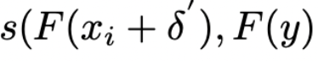
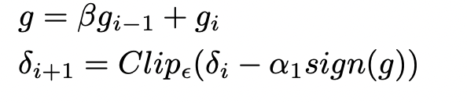
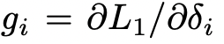
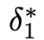
Minimizing Loss Function
Is raw probability prediction of xi + δ being recognized as y by model
Suppose Ө = 1, higher similarity b/w xi + δ and y leads to L1 becoming 0
We Projected Gradient Descent with momentum method to update δ
g: momentum gradient with hyperparameter β
Notes:
Theta : probability predictions of the model cosine similarity when y is adversarial input (training data).we are setting a lower limit on the value of loss. Hence, by controlling the parameter k we can specify how confident we want our adversarial to be classified as
momentum, which is a moving average of our gradients.With Stochastic Gradient Descent we don’t compute the exact derivate of our loss function. Instead, we’re estimating it on a small batch. Which means we’re not always going in the optimal direction, because our derivatives are ‘noisy’. Just like in my graphs above. So, exponentially weighed averages can provide us a better estimate which is closer to the actual derivate than our noisy calculations

Slide 13
Noise Analysis: Step1
Adversarial Noise variation with time
Speaker Feature Variation

Slide 14

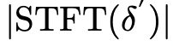
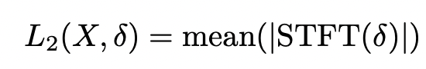
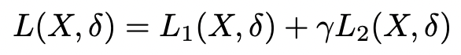
Step2: Correct speech recognition
Goal: optimizing δ to reduce the impact on speech recognition (unperceivable by humans)
STFT(x) is used to obtain Frequency spectrum of input audio x
Final Optimization function:
Notes:
converts the signal from the time domain into the frequency domain. Start from delta*.

Slide 15
Noise Analysis : Step2
Adversarial Noise variation with time
Speaker Feature Variation
(4446 to 1995)

Slide 16
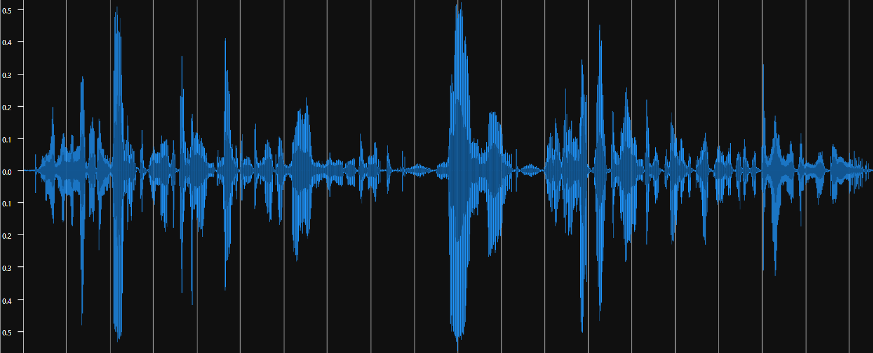
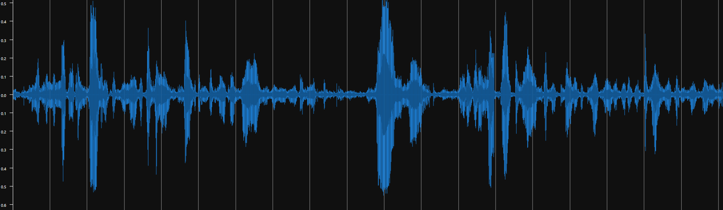
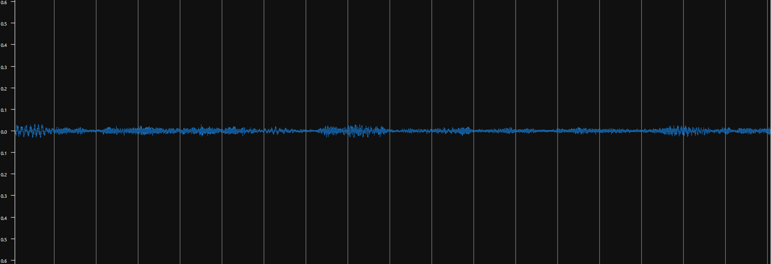
Adversarial output generation
Original audio (Speaker #1)
+
Output audio (Predicted Speaker #2)
Noise after step2

Slide 17
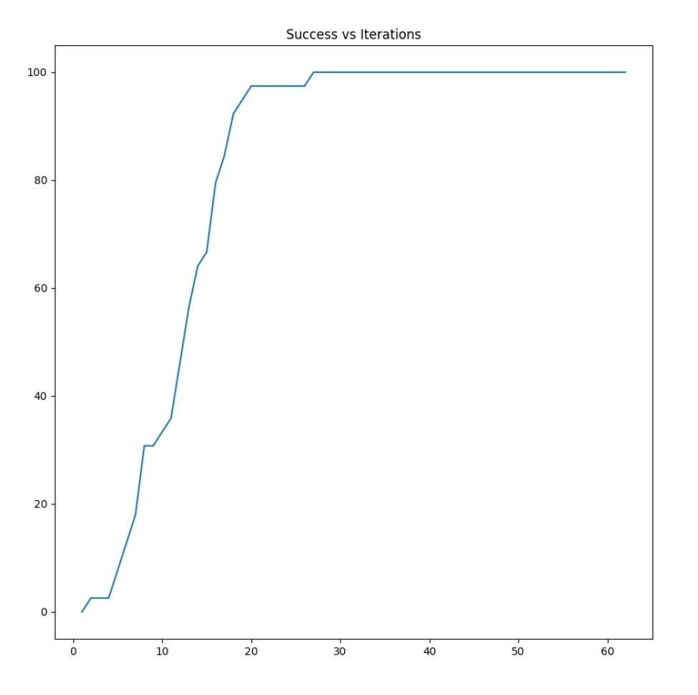
Attack Success Rate
Notes:
Num 12

Slide 18
How to improve the attack
The noise generated by this step is quite high and can be detected if listened closely.
Currently we are using ResNet model, we could make a more robust model with attention mechanism
Attention could be incorporated in the attack model
It will help the model to identify the key features that differentiates different speakers
It will also help us to fasten the learning process as a more robust noise could be generated
Also, training the model on a larger dataset might also lead to better defence
Notes:
How exactly will inclusion of attention can improve our model?

Slide 19
Future Work
In the current model, we have assumed that the speaker recognition model is known to us
We could extend this towards black box approach where the exact model structure is not known.
Adversarial examples can be made more practical with integrations such as room impulse response i.e. taking the environment into account.
Experimenting with this model on a different dataset

Slide 20
Random things
Making Speaker model robust (?)
We tried to modify the speaker model by adding attention
Attack rate was higher than original
Reason:
Could not train on entire dataset due to lack of computational resources.
Less robust to noise
Making CW loss function faster (!)
Introduced non-linearity
Initially converged faster
Later slowed down than original

Slide 21

Demo
Original Speaker’s audio (1580) -
Target Speaker’s audio (1221) -
Noise generated (1580 - 1221) -
Adversarial audio -

Slide 22
References
Attack on practical speaker verification system using universal adversarial perturbations
Github - Attack_practical_asv
AdvPulse: Universal, Synchronization-free, and Targeted Audio Adversarial Attacks via Subsecond Perturbations
Adv Pulse
Adversarial Attacks and Defenses for Speech Recognition Systems
Who is Real Bob? Adversarial Attacks on Speaker Recognition Systems
Github - Transferbility of AEs

Slide 23
Open for Questions

Slide 24
Appendix

Slide 25
Demo
Original audio (1580)
+
Output audio (1221)
Noise

Slide 26
Why the attack is successful?
We have combined Carlini-Wagner (CW) objective function and Projected Gradient Descent (PGD) methods
N audios of the adversary was taken so as to include various features such as tune, emotion, speech content etc.
After the algorithm converges, we are able to
Notes:
N is taken to be large enough to have a great diversity of these features.

Slide 27
How to improve the attack
The noise generated by this step is quite high and can be detected if listened closely.
Currently we are using ResNet model, we could make a more robust model with attention mechanism
It which will help the model to detect the features which differentiates between speakers.
Training the model on a larger dataset might improve the noise generated.
Notes:
There are certain things that we can do Lie in the scope of this project

Slide 28
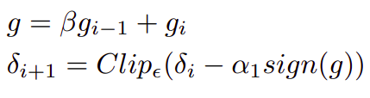
Why the attack is successful
All the N audios ({x₁, x₂, … , x_{N}}) are set to be of equal length “l” (max length of audio in the set) by repeating the audio.
Noise i.e. δ’ is randomly initialized and added into each train audio.
L₁(X,δ) is computed in one forward pass.
To minimize L₁(X,δ), we use PGD with momentum to update δ.
where g_{i} = ∂L₁/∂_{δi} where g_{i-1} is obtained using back propagation
β is the hyperparameter. α₁ is the learning rate
Clip_{ε} performs element-wise clipping of δ
Notes:
Check where did gi came from
Beta is the hyperparamter

Slide 29
